Slide 1
Used Car Price Prediction
Marcos Wang
Springboard Data Science Career Track

Slide 2
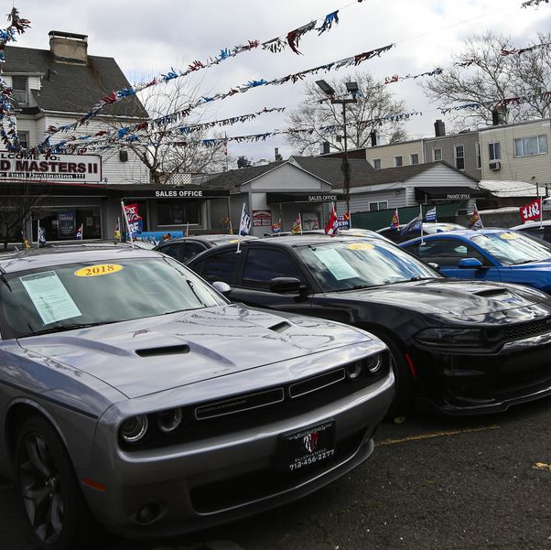
The problem
Used car prices has skyrocketed since 2020
Supply chain & logistic delay
What factors affects the car price?
Can we predict the price for used cars?

Slide 3





Who might care?
Car Dealers Car Buyers Mobile apps
…and many more…

Slide 4
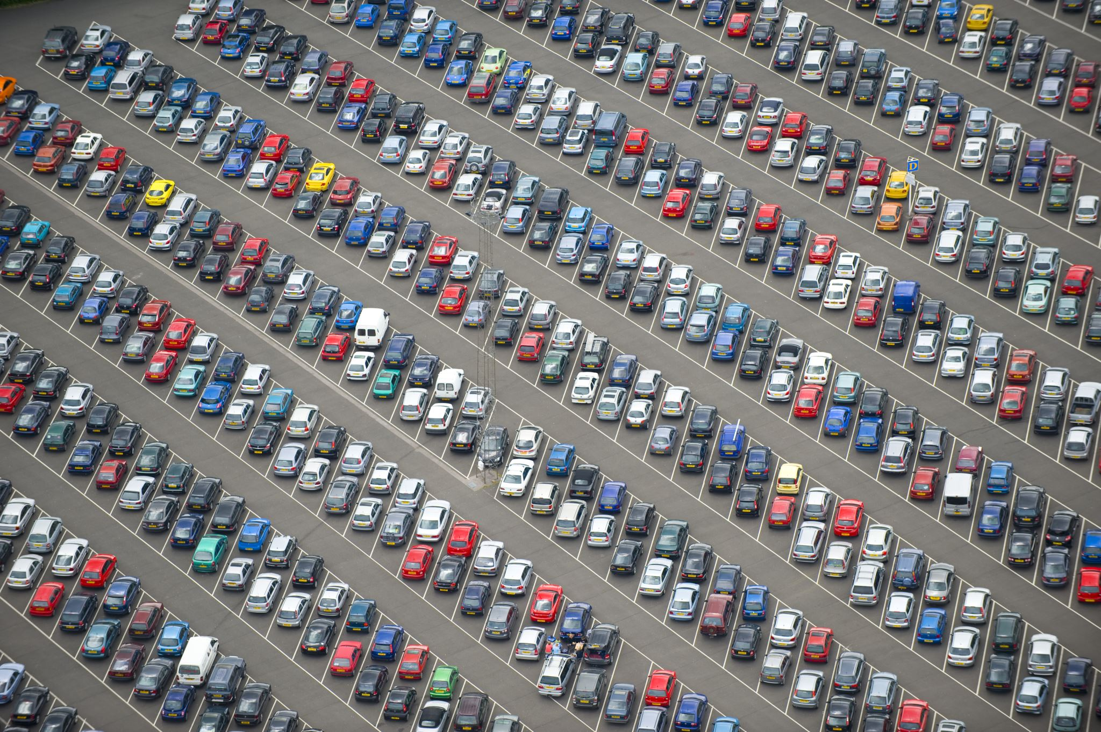
What factors determine the car price
Make
Model
Mileage
Age
City
State

Slide 5
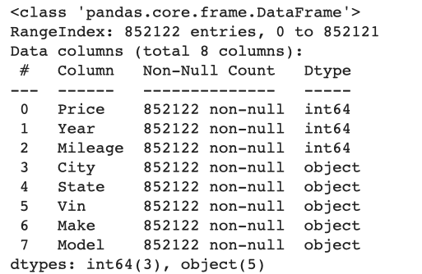

Data Information
Data acquired from Kaggle
Number of records: 852,122
3 numerical features
5 categorical features

Slide 6
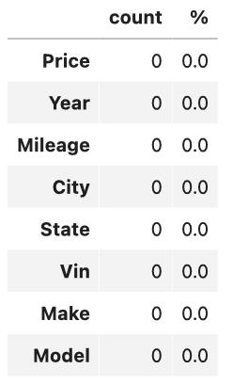
Data Wrangling
Checking missing values Checking duplicated values
Create ‘Duplicated’ Column
Drop duplicated values
No missing values
852,092 record after cleaning

Slide 7

Exploratory Data Analysis
5 questions to explore
What’s the average car price per year
What are the 5 most expensive car models
Which feature correlates the most with the price
What state sold most used car
Which year of car are best selling

Slide 8
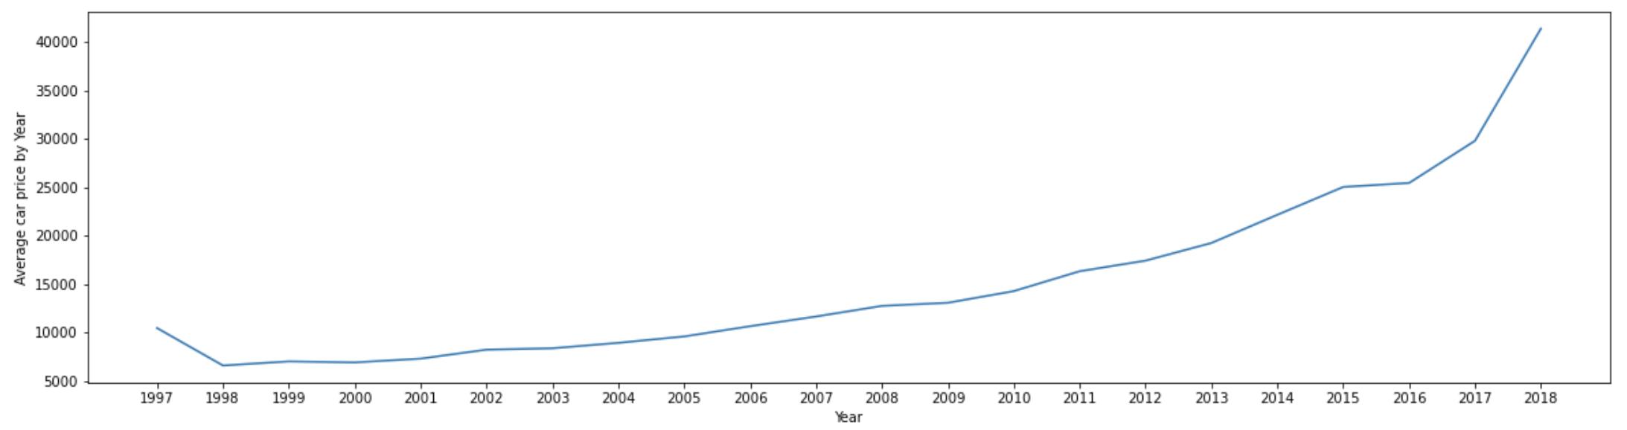
What’s the average car price per year

Slide 9
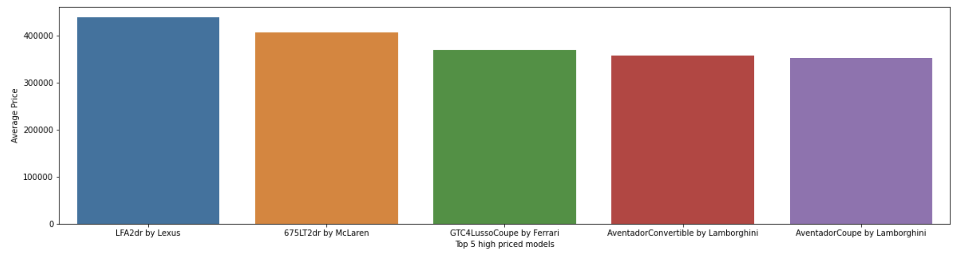
What are the 5 most expensive car models

Slide 10
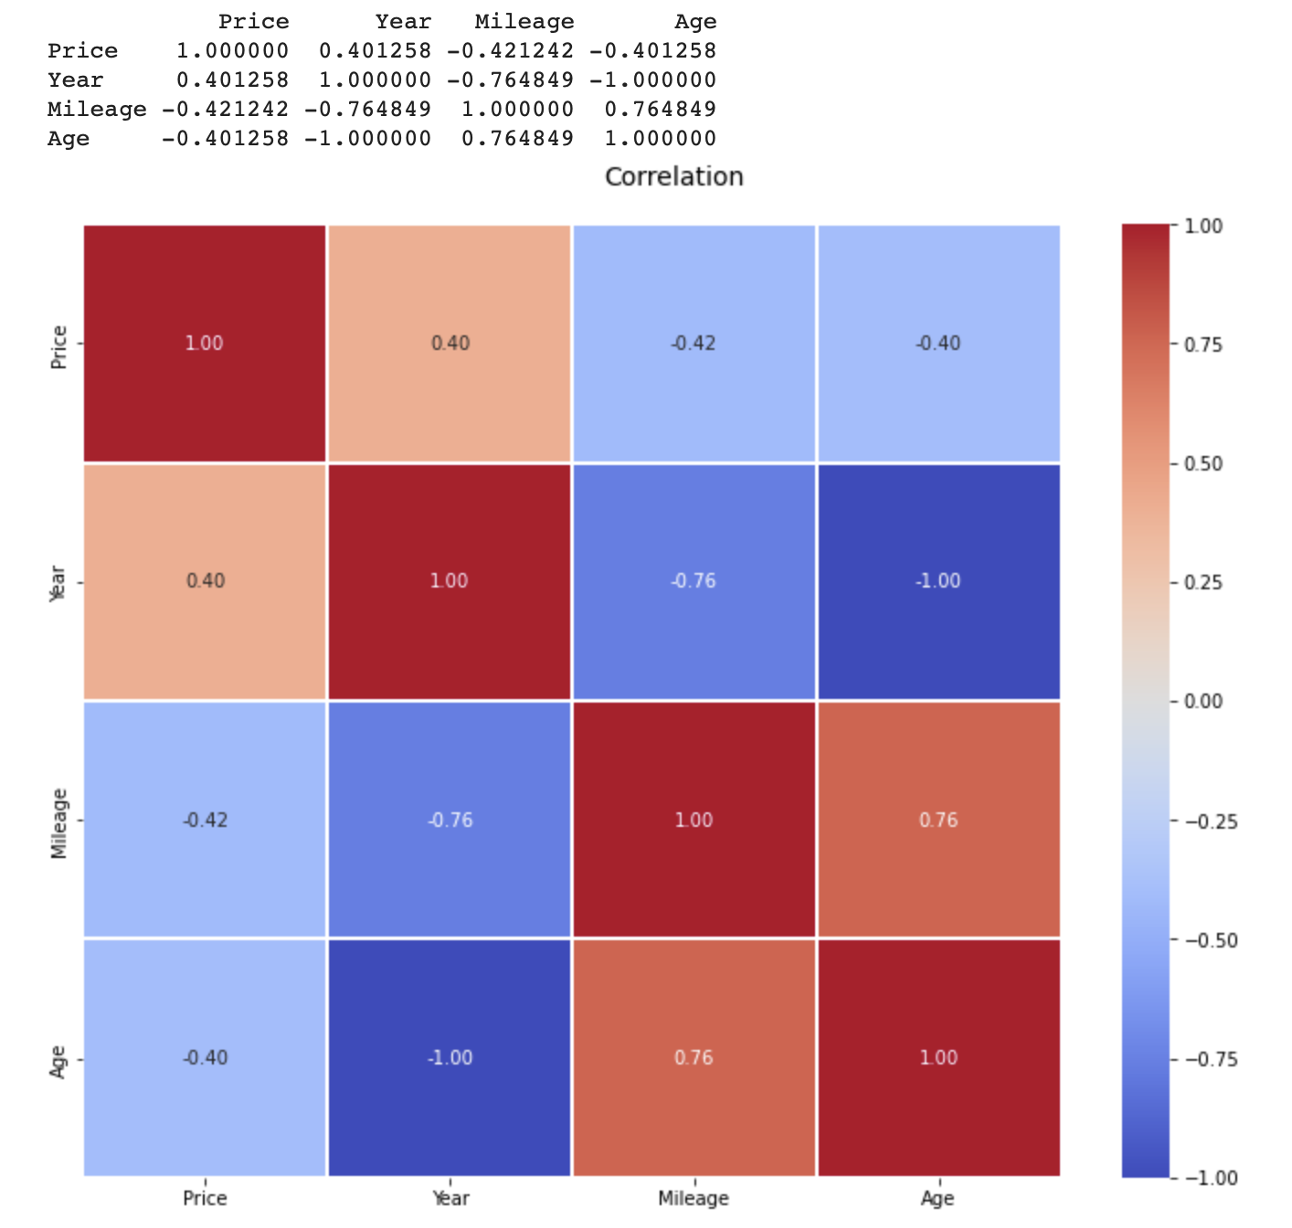
Which feature correlates the most with the price

Slide 11
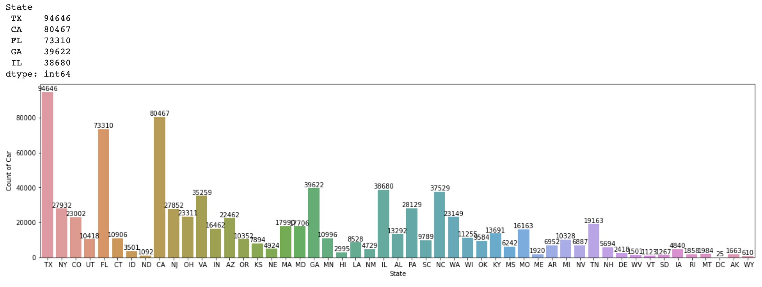
What state sold most used car

Slide 12
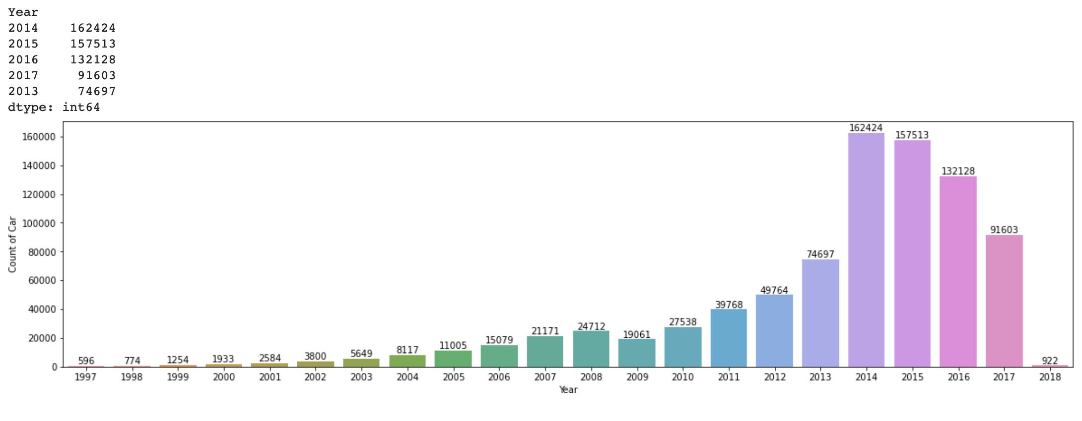
Which year of car are best selling

Slide 13

Pre-processing and Training Data Development

Slide 14

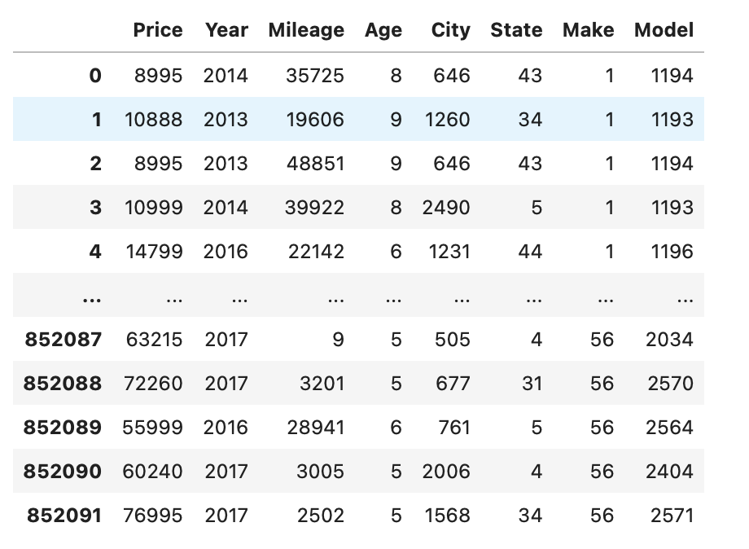
Categorical Features Splitting Data Scaling
Label Encoder X = Price Standardization
80/20 Standard Scaler

Slide 15
Modeling
Linear Regression
Random Forest Regressor
Adaptive Boosting Regressor

Slide 16

Winner: Random Forest Regressor
R2 score = 0.9662798070787618

Slide 17
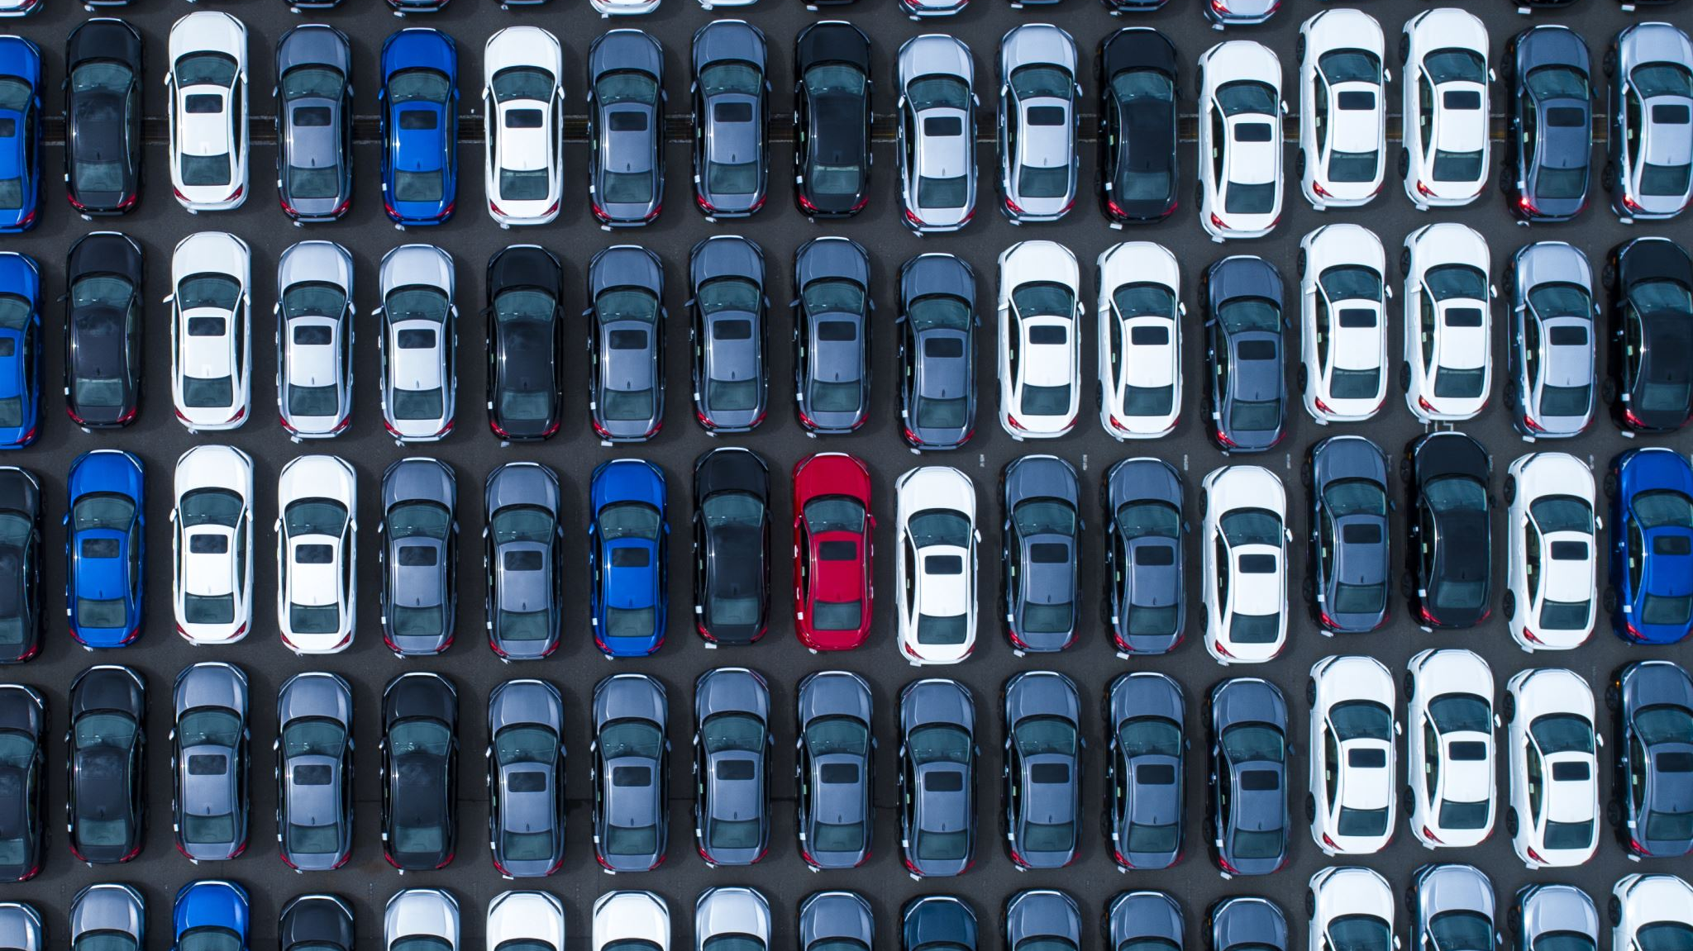
Conclusion
Mileage and age of the car affect the selling price the most.
Out of 3 supervised regression models, the Random Forest Regressor provided the best results
With more dataset with features such as the date that the car is sold, accident history and etc, the model can be improved in the future.

